Slide 1
205, Feb 23, Class 22
Final projects
Start building your procedure online
Ethics 2: Responsible Conduct of Research

Slide 2
Vaccine skepticism
In 1998, Andrew Wakefield and 12 of his colleagues published a case series in the Lancet, which suggested that the measles, mumps, and rubella (MMR) vaccine may predispose to behavioral regression and pervasive developmental disorder in children.
Despite the small sample size (n=12), the uncontrolled design, and the speculative nature of the conclusions, the paper received wide publicity, and MMR vaccination rates began to drop because parents were concerned about the risk of autism after vaccination.

Slide 3
Taylor et al (1999) examined 498 cases of autism
There was no difference in age at diagnosis between the cases vaccinated before or after 18 months of age and those never vaccinated.
There was no temporal association between onset of autism within 1 or 2 years after vaccination with MMR (relative incidence compared with control period 0.94 [95% CI 0.60-1.47] and 1.09 [0.79-1.52]).
Lancet (2004) reviewed allegations against Wakefield
Acknowledged that Wakefield had a significant “conflict of interest”
Dismissed allegations of improper recruiting, patient selection

Slide 4
Full Investigation
Wakefield was paid over £400k by lawyers trying to sue vaccine companies in the two years before the study
Had already asserted a vaccine/bowel/autism link before data were collected
Written communication asked him to find a “temporal link”
Analysis of the 12 patients revealed none matched their actual medical records
Patients mostly knew each other and were recruited due to vaccine concerns and were pre-interviewed for consistency with the hypothesis before enrolling in study
Several had documented symptoms pre-dating vaccination (developmental delays and/or GI problems)
Data linking the time from vaccination to diagnosis were incorrect, inconsistent data were excluded
Full retraction of the paper from Lancet in 2010
Wakefield lost medical license

Slide 5
Research Integrity
Brian Deer, journalist, did most of the investigation uncovering the research fraud
Funded by the Sunday Times of London and the Channel 4 television network.
Reports by Deer in the BMJ were commissioned and paid for by the journal.
No other funding was received, apart from legal costs paid to Deer by the Medical Protection Society on behalf of Andrew Wakefield.
All claims in Deer’s articles consistent with investigation from the British General Medical Counsel assessed by editors at the British Medical Journal
Took 12 years to investigate, find fraud and retract paper

Slide 6
Responsible Conduct of Research
Researcher processes with rigor and integrity
Don’t lie, cheat or steal
Data Manipulation
Forgery: fabrication or modification
Data selection
Eliminating all data inconsistent with the hypothesis
Bias in recruiting, protocol administration or data scoring

Slide 7
Analytic Flexibility
File drawer effect
Re-running or re-starting the experiment repeatedly until it “works”
“p-hacking”
Trying different analysis approaches until it “works”
Normal processes that seem similar
Pilot testing
Data exploration
Standard exclusion/filtering processes
When is it too much?

Slide 8
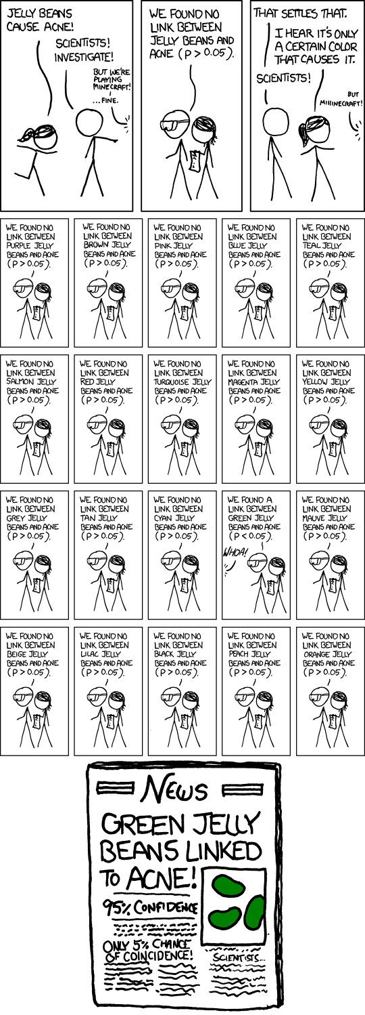

Slide 9
Reproducibility
Research that meets the p<.05 statistical criterion should replicate if repeated
Except for power issues or generalizability questions
Weak processes for research rigor make this less likely
Even typical lab processes risk inflating the estimated effect size
Replication crisis approaches
More rigor, fewer studies with greater confidence
More studies without increasing rigor, build in replications

Slide 10
Plagiarism
Citation strengthens reports
Novel findings have value
Build on existing ideas
Actual appropriation of others’ ideas
Scooping other labs
Pre/re publishing manuscripts
Authorial credit to collaborators and research team
Significant intellectual contribution
Definition varies across psychology, medicine for example
Not uncommon source of in-laboratory friction

Slide 11
Being Public
All aspects of the research process are auditable
Participant privacy must still be protected
Researchers protected from exposure to competing labs
Patent, copyright, and invention privacy
Publication
Full, fair & accurate reporting, making all resources available
Not always practically effective
Supplementary materials via journal website
Public availability of de-identified data
Does not always include excluded data

Slide 12
RCR Errors
Suppose a friend doing a research project said to you, “I’m sure my hypothesis is correct, so I’ll just give my participants a hint here and there to make sure the data come out properly.”
What kind of RCR violation is this?
What methodological approach should be used by this research to avoid this problem?

Slide 13
RCR Errors
A researcher doing a study on academic performance of students who have been diagnosed with ADHD. Some of the potential participants have refused to answer the question about their diagnosis, so the researcher contacts their medical provides without the participant’s knowledge.
What kind of research ethics violation has occurred here?

Slide 14
Intervention research
Give an example of a research study not included in the chapter for which it would be unethical to include a placebo/control group.
Why are rules requiring reporting of conflict of interest important for ensuring accurate and fair scientific processes and reports?

Slide 15
Training intervention with Military personnel
Can memory theory be used to accelerate training?
Intervention to speed learning
Targeted skill training
Shorter time course, 4-6 weeks
Large numbers of students, all getting identical content
Training may improve performance on key skills
How to design this ethically?

Slide 16
Crossover Intervention Design
Test 1: A1 versus B1
Test 3: A1 versus A2
A
Assessment - 1
A1 Scores, Cohort A
T3
Assessment- 2
A2 Scores, Cohort A
Intervention Training
No training
Random assignment within a single class, half students to “A” cohort and half to “B” cohort
T1
B1 Scores, Cohort B
B2 Scores, Cohort B
No training
Intervention training
B
T2
Test 2: B1 versus B2

Slide 17
Philosophical Ethical Challenges
When the experimental treatment is a benefit
Justice would normally mean equal benefits across groups
Intervention research on Monday
Coercion versus voluntary participation
Authority figures: supervisors, teachers
Financial rewards: incentivizing risk
Vulnerable populations
Children: depend on guardian
Mandatory reporting training for staff
Prisoners: cannot voluntarily consent
Research must be for prisoners’ benefit

Slide 18
For Mon 2/26
Chapter 19: Applied research
Cunningham (1989)
Wednesday, Chapter 20
Developmental psychology and Neuropsychology
Friday, Exam 2
Project presentations Mar 4 (Mon) and Mar 6 (Wed)

Slide 19
A Science Fair’s Teachable Moment
A science fair project done by an 8yo girl, “Does Skin Color Make a Difference?” (Boulder, Colorado)
2001 school science fair
School board panicked and censored the results for fear of “insensitivity”
Design: Two Barbie dolls, one white and one black. One Barbie is wearing a lavender (preferred) dress. The question is “which doll do you prefer?”
30 adults and children were asked. Adults consistently preferred the lavender dress (e.g., 27 of 30 times).
Among children, only 6 picked the lavender dress if the Black Barbie wore the dress.

Slide 20
Adults’ preference
Adults | Lavender | Other
Black-Lavender | 13 (.867) | 2 (.133)
White-Lavender | 14 (.933) | 1 (.067)
X²<1.00, p>0.50

Slide 21
Children’s preference
Children | Lavender | Other
Black-Lavender | 6 (.40) | 9 (.60)
White-Lavender | 15 (1.0) | 0 (.00)
Average rate choosing the Lavender dress is 21/30 = 0.70
Expected value (null hypothesis) = 10.5 Lavender, 4.5 Other
X²=12.86, p<0.001

Slide 22
Do Adults and Children react differently?
 | Lavender | Other
Adults | 13 (.867) | 2 (.133)
Children | 6 (.40) | 9 (.60)
Total | 19 (.633) | 11 (.367)
X²=7.02, p<0.01

